Slide 1
RStudio Web Service API Azure ML
DEMO V1
Notes:
We will have someone read the introduction, discovery, consumption and publishing spiel and leave this up on the screen. Don’t move onto slide two until we are beginning the demo.

Slide 2
Steps
Set Working Directory
Compile all of consume, discover, publish functions
Set local workspace id and authentication token
Install all packages
Set up Rtools

Slide 3
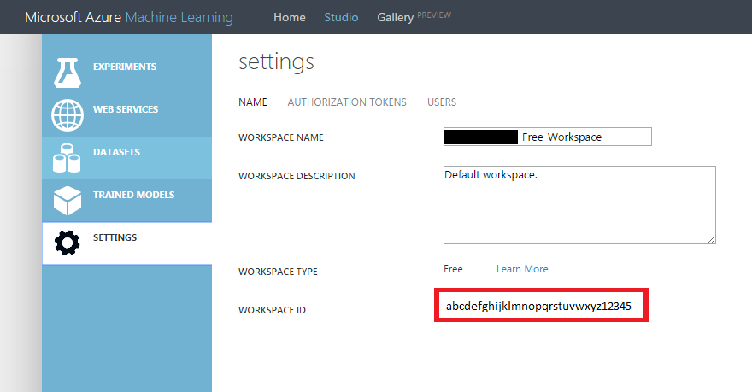
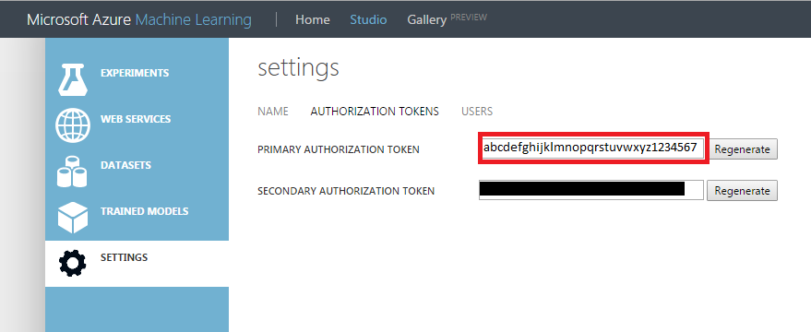
Getting Started
Go to https://studio.azureml.net/ and gather your Workspace information
Go to Settings
Grab Workspace ID
Switch over to Authorization Token tab and grab the token
**Would be a good idea to save these as a global variable as it is necessary for most functions**

Slide 4
User Functions
Discovery
getEndpoints(wkID, authToken, wsID, url=epURL)
getEPDetails(wkID, authToken, wsID, epID, url=epURLdet)
getWebServices(wkID, authToken, url=wsURL)
getWSDetails(wkID, authToken, wsID, url=wsURLdet)
Consumption
consumeFile(api_key, requestURL, infileName, globalParam = "", outfileName = "results.txt", batchSize = 250, retryDelay = 0.3)
consumeLists(api_key, requestURL, columnNames, ..., globalParam="", retryDelay = 0.3)
consumeDataframe(api_key, requestURL, valuesDF, globalParam="", batchSize = 250, retryDelay = 0.3)
Publishing
publishWebService(functionName, serviceName, inputSchema, outputSchema, wkID, authToken)

Slide 5
publishWebService(functionName, serviceName, inputSchema, outputSchema, wkID, authToken)
inputSchema = list("arg1"="type", "arg2"="type", ...)
outputSchema = list("output1"="type", "output2"="type", ...)

Slide 6
Included Packages
RCurl,
RJSONIO,
uuid,
jsonlite,
codetools,
base64enc,
functional,
Httr
Data.table
Notes:
These packages need to be installed

Slide 7
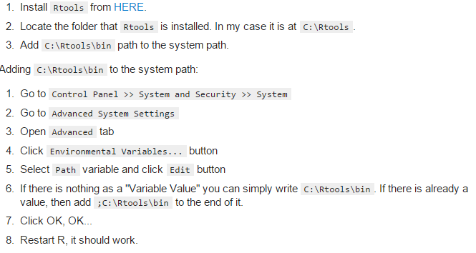
Set up Rtools
http://cran.r-project.org/bin/windows/Rtools/

Slide 8
Sources
Downloading Rtools:
http://stackoverflow.com/questions/29129681/create-zip-file-error-running-command-had-status-127

